Slide 1
Local Architecture Review Board (JDK Upgrade Project)
Building Permit
Prepared by Transformation & Team
November 12, 2025

Slide 2
1. Introduction
2. Business Architecture Focus
3. IT Solution Architecture & Complexity Focus
4. Approach Focus
[Appendix]

Slide 3
1. Introduction
Why are we doing this?

Slide 4
백성규
Business Rationale
목적 : Tech-debt, JDK 1.5 → OS EOS 해결하지 못하서 보안 취약점에 노출되어 있음, 그리고 해당 JDK1.5를 사용하는 application Core, WAS, WEB, F/W
Impact : SSO, RD, batch scheduler, DEVOPS 환경, 성능, 가능성
Vision:
Provide stakeholders with reliable topline dashboards by using Tableau to accelerate business-oriented decision under consistent governance
Establish a unified, SQL-based Data Cube integrating Motor, GI, and LI businesses into standardized, query-driven structures, ensuring a single source of truth across divisions
Architecture Considerations:
Scalable Dashboard Design : Design dashboards and data models to handle growing data volume and expanding business requirements without performance degradation
System Integration : Ensure seamless connectivity with existing data warehouse, CRM, finance, and marketing systems to provide a consolidated enterprise view
Security & Access Control : Apply role-based permissions, certified data sources, and audit logging to ensure data confidentiality, compliance, and governance
Performance Optimization : Implement extract strategy, query optimization, and caching mechanisms to support real-time reporting and executive dashboards
Usability & Ease of Operation : Ensure Tableau dashboards and authoring tools are intuitive and easy to use, enabling business users to build, modify, and consume insights without heavy IT dependency
목적 : Tech-debt, JDK 1.5 → OS EOS, WAS EOS, ProFrame EOS, AP EOS, HTTP
Problem Statement:
While various dashboards are being developed across divisions, there is no unified view that consolidates information into an enterprise-wide dashboard
Data sources are scattered across multiple systems, and critical resource-related data lacks sufficient governance and management processes
Reporting activities rely heavily on manual processes, creating a risk of errors and delays in delivering
목적 : JDK 21, Tomcat, 차세대 F/W, 유지보수 생산성 높일수 있다. HTTPS
Intended Outcomes:
Delivery of standardized, automated dashboards with drill-down features, improving transparency, efficiency, and reliability of reporting
Establishment of a SQL based data cube integrating Motor, GI, and LI business into standardized, query-driven structures, serving as the single source of truth across divisions
Clear governance of data, ensuring consistent KPI tracking and reducing manual dashboard workload across relevant Divisions
Architectural Significant Elements:
Visualization Performance Architecture : Designing dashboards with optimized queries, extracts, and caching to handle large datasets while maintaining responsiveness and stability.
Governance & Security Architecture : Applying role-based access control, certified data sources, and audit logging within Tableau to ensure trusted insights, and compliance with security standards.
Initiative Timing:
Kick Off : Apr 17, 2025
Gate 1 (MC Committee) : Sep 10, 2025
POC period : Sep 01 ~ Sep 16, 2025
LARB Dates : Nov 12, 2025
Gate 2 Approval (BAU): Nov 17, 2025
Vendor Dashboard Visualization : Feb 02 ~ Apr 30, 2026
Topline Delivery : May 06, 2026
목적 : OSS S/W 사용해서, 업체 dependency 줄임
Implementation Risks and Mitigation:
Project Schedule Delay : Internal or external decision making and alignment among departments and vendor may take longer than expected, causing schedule slippage => Set clear milestones and governance structure with weekly progress tracking and escalation to the weekly committee when delay risk is detected
목적 : 프로젝트의 RISK관리에

Slide 5
2. Business Architecture Focus
How will this change the business?

Slide 6
김광삼
Business Blueprint Evolution
 | Impacted | CURRENT STATE (2025.09) | END STATE (2026.03)
Customer Interaction | Which customer interaction mechanisms will be created, changed, or removed? | CM에서 호출하는 레가시 Core의 application jdk,WAS, HTTP
Partner Interaction | Which partner interaction mechanisms will be created, changed, or removed? | B2B : extranet.axa.co.kr (자동차보상, 일반계약) application jdk,WAS, TLS 1.1
Processes (Processes & Functions) | Which processes and functions will be created, changed or removed and how will automation be applied? | N/A | N/A
Organization (Organization, Staff, Skills and Culture) | Which parts of the organization will be created, changed or removed? Which roles and skills will be created, changed or removed? | 현재는 IT 개발조직에서 습득해야 하는 F/W의 종류가 5가지여서… | 2~3개로 표준화됨으로.
Technology (Technology, Tools, IT & Buildings) | Which technology, IT, tools or buildings will be created, changed or removed by the project? | jdk,WAS, HTTP
Information (Information & Data) | What data or ways of using data will be created, changed or removed? | N/A | N/A

Slide 7
노재풍
Business Capabilities Mapping
Business capabilities in scope & their dependencies positioned on the Business Capabilities Reference Model
 | Strategic
 |  |  |  |  |  |  | BUSINESS DIRECTION MGMT |  | BUSINESS TRANSFORMATION MGMT |  | BUSINESS GOVERNANCE MGMT |  | BUSINESS RESPONSIBILITY MGMT
 |  |  |  |  |  |  | Mission Mgmt |  | Strategy Mgmt |  | Business Policy Mgmt |  | Communication Mgmt
 |  |  |  |  |  |  | Vision Mgmt |  | Operating Model Mgmt |  | Corporate Risk Mgmt |  | Stakeholder Mgmt
 |  |  |  |  |  |  |  |  | Architecture Mgmt |  | Compliance Mgmt |  | Corporate Social Responsibility Mgmt
 |  |  |  |  |  |  |  |  | Innovation Mgmt |  | Legal Service Mgmt
 |  |  |  |  |  |  |  |  | Research & Development Mgmt
 | Core
 | DISTRIBUTION CHANNEL MGMT |  | CUSTOMER MGMT |  | INTERMEDIARY MGMT |  | PROVIDER MGMT |  | INTERACTION MGMT |  | MARKETING & SALES MGMT |  | VALUE PROPOSITION CREATION MGMT |  | PROPOSITION AGREEMENT MGMT |  | PROPOSITION ADMINISTRATION MGMT |  | PROPOSITION FULFILMENT MGMT |  | BILLING & PAYMENT MGMT
 | Distribution Channel Insight Mgmt |  | Customer Insight Mgmt |  | Intermediary Insight Mgmt |  | Provider Insight Mgmt |  | Touch Point Mgmt |  | Brand Mgmt |  | Value Proposition Development Mgmt |  | Proposition Exposure Mgmt |  | Contract Lifecycle Mgmt |  | Claims Mgmt |  | Charging Mgmt
 | Distribution Channel Administration |  | 360 Degree Customer View Mgmt |  | 360 Degree Intermediary View Mgmt |  | 360 Degree Provider View Mgmt |  | Request Mgmt |  | Market Insight Mgmt |  | Value Proposition Lifecycle Mgmt |  | Contract Risk Evaluation Mgmt |  | Financial Product Mgmt |  | Service Fulfilment Mgmt |  | Invoice Mgmt
 |  |  | Customer Relationship Mgmt |  | Intermediary Relationship Mgmt |  | Provider Relationship Mgmt |  | Collaboration Mgmt |  | Campaign Mgmt |  | Pricing Mgmt |  | Customer Advice Mgmt |  | Customer Estate Mgmt |  | Customer Support Mgmt |  | Customer Payments Mgmt
 |  |  | Customer Community Mgmt |  | Intermediary Network Mgmt |  | Provider Network Mgmt |  | Experience Mgmt |  | Sales Funnel Mgmt |  | Contract Risk Acceptance Mgmt |  | Proposition Management |  | Contract Portfolio Mgmt |  | Customer Dispute Mgmt |  | Revenue Sharing Mgmt
 |  |  |  |  |  |  |  |  |  |  | Sales Performance Mgmt |  |  |  | Retention Mgmt |  | Commercial Risk Mgmt |  | Recovery Mgmt
 |  |  |  |  |  |  |  |  |  |  |  |  |  |  |  |  |  |  | Risk Consulting Mgmt
 | Supporting
 |  |  | WORKFORCE MGMT |  | OPERATIONS MGMT |  | FACILITIES MGMT |  | FINANCE MGMT |  | TRANSFORMATION MGMT |  | PROCUREMENT MGMT |  | INFORMATION MGMT |  | TECHNOLOGY MGMT
 |  |  | Workforce Lifecycle Mgmt |  | Operational Plan Mgmt |  | Physical Workplace Mgmt |  | Financial Planning Mgmt |  | Portfolio Mgmt |  | Procurement Risk Framework Mgmt |  | Data Resource Mgmt |  | IT Service Mgmt
 |  |  | Identity & Access Mgmt |  | Operational Crisis Mgmt |  | Health & Safety Mgmt |  | Financial Accounting Mgmt |  | Program and Project Mgmt |  | Procurement Operations Mgmt |  | Master Data Mgmt |  | Infrastructure Mgmt
 |  |  | Workforce Competence Mgmt |  | Business Process Mgmt |  | Fleet Mgmt |  | Financial Transaction Mgmt |  | Change Mgmt |  | Purchase Mgmt |  | Meta Data Mgmt |  | Software Mgmt
 |  |  | Workforce Performance Mgmt |  | Operational Resiliency Mgmt |  |  |  | Tax Mgmt |  | Quality Mgmt |  |  |  | Knowledge Mgmt |  | License Mgmt
 |  |  | Workforce Reward Mgmt |  | Service Catalogue Mgmt |  |  |  | Asset Mgmt |  | Benefits Mgmt |  |  |  | Business Intelligence Mgmt
 |  |  | Workforce Service Mgmt |  | Fraud Mgmt |  |  |  |  |  |  |  |  |  | Information Security Mgmt
 |  |  | Workforce Relations Mgmt |  |  |  |  |  |  |  |  |  |  |  | Content Mgmt
Scope
Dependencies

Slide 8

이승민
Architecture Benefits & Measures
What benefits do we expect the architecture to deliver and how we measure that it has been successfully implemented.
Please consider decommissioning, complexity, flexibility, speed of change, security, data quality and accessibility etc.
Architecture Impact | Measure | Current KPI | Target KPI
자동차 계약의 impact | Application Complexity Index Score 측정 (5가지 측정 항목 표시) |  | Invest
자동차보상의 impact | Application Complexity Index Score 측정 (5가지 측정 항목 표시) | 박상후 자료 제공 | Invest
일반 계약의 Impact, TM impact, customer impact, p&R impact, account impact | Application Complexity Index Score 측정 (5가지 측정 항목 표시) |  | Ensure data quality, certified dashboards, audit compliance
Nets, RD, Batch scheduler impact | Application Complexity Index Score 측정 (5가지 측정 항목 표시)
2,2

Slide 9
3. IT Solution Architecture and Complexity Focus
What is the solution?

Slide 10
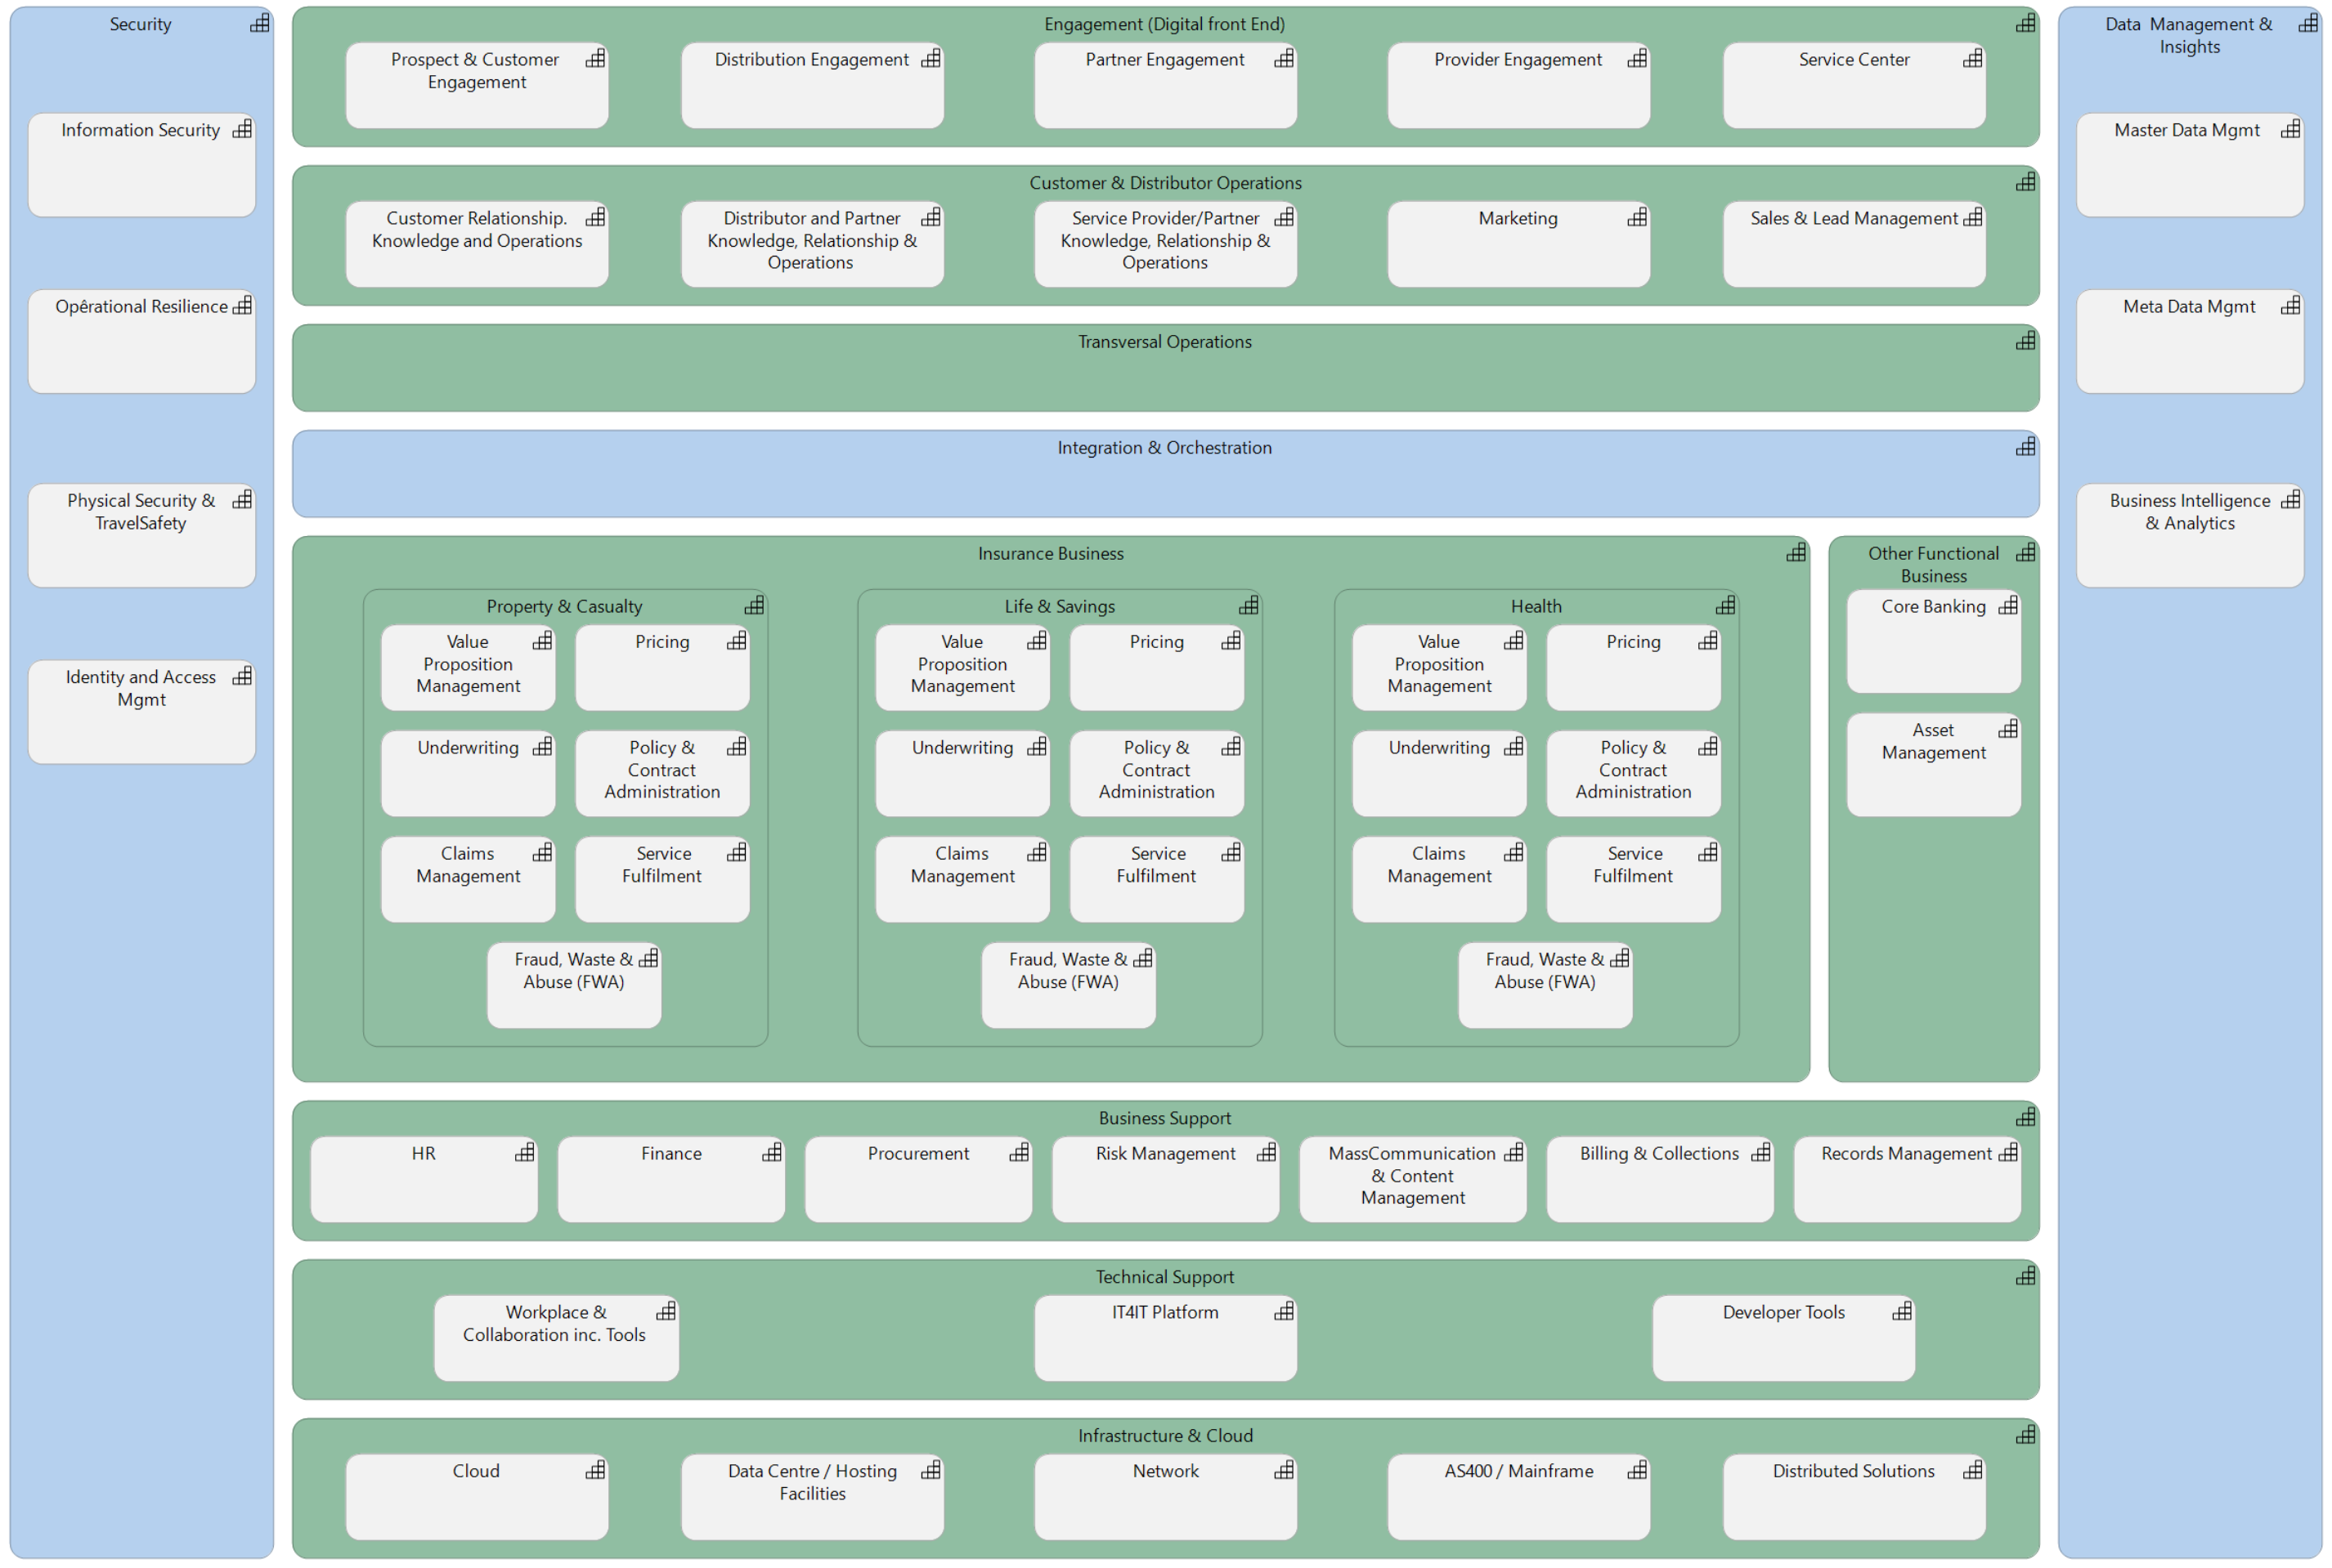
Legend:
Modification to existing solution or service
New AXA solution or service
Impacted Domains
New external service outside AXA

Slide 11
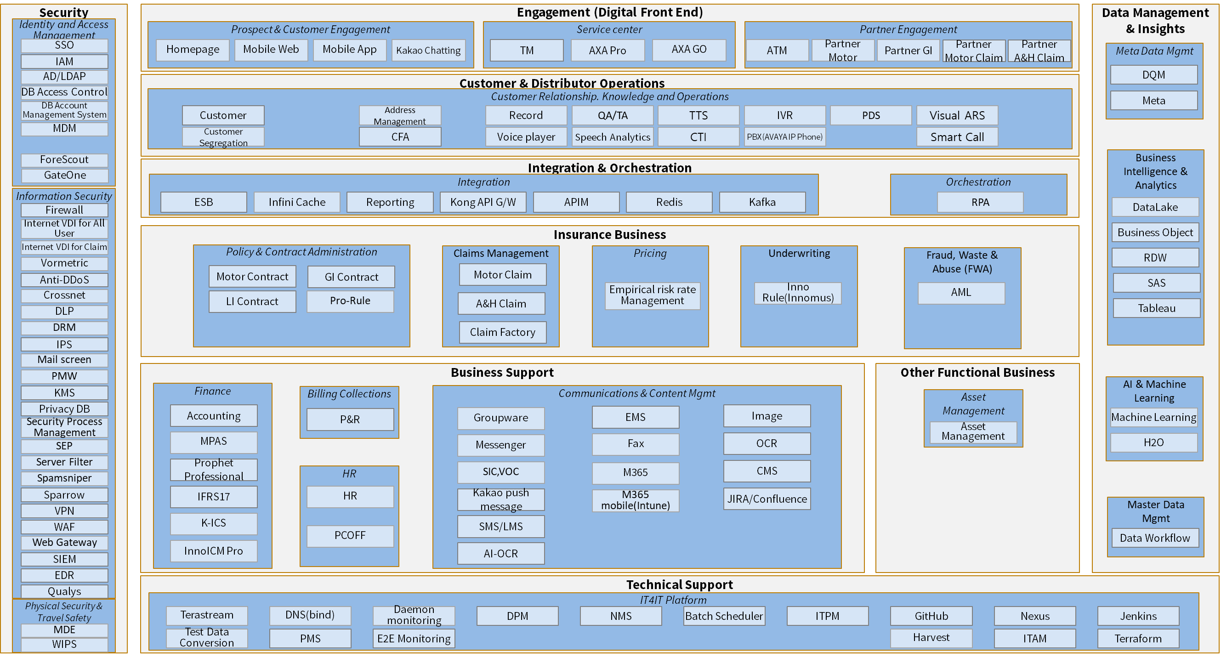
IS Architecture (As-Is)

Slide 12
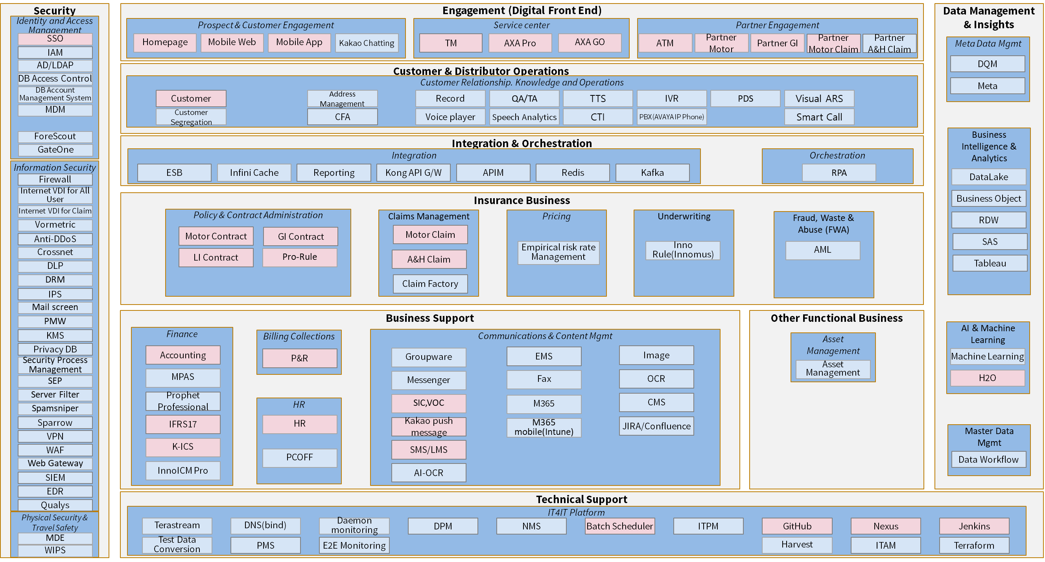
IS Architecture (To-Be)

Slide 13
백성규
Selection Approach
Project requirements were delivered to two vendors, followed by a technical evaluation and RFP process to assess their proposals.
G
Green
A
Amber
R
Red
No. | Criteria | Evaluation | Bigxdata |  | Milvus
1 | Architecture/ Standard | Deployment flexibility | G | On-prem or SaaS | G | On-prem or SaaS
 |  | Security & IAM | G | SSO, fine-grained permissions (groups/inheritance), row-level security, TLS/E2E encryption. | G | SSO, fine-grained permissions (groups/inheritance), row-level security, TLS/E2E encryption.
 |  | Integration with Oracle / PostgreSQL / Databricks | G | Native connectors | G | Native connectors
2 | Requirement Coverage | Fit for topline dashboard requirements | G | Requirement fulfilled during POC Period | R | Requirements not fulfilled during POC / Delayed delivery
3 | Project Delivery | Implementation timeline | A | Requires more time than initially planned for the project timeline | A | Requires more time than initially planned for the project timeline
4 | Vendor qualification | Local reference in financial industry | G | Tableau Premier Reseller Extensive experience in the insurance sector | A | Tableau Premier Reseller Limited references in the insurance sector
 |  | Technical support & skills | G | Dedicated local partner support, with regular training program | G | Dedicated local partner support, with regular training program
5 | Total Cost Ownership | Dashboard Visualization + License cost | G | Moderate - within budget Dashboard: KRW 102,300,000 (9.5M/M) Licenses: KRW 19,800,000 | A | Amber – Opex over budget Dashboard: KRW 82,500,000 (6.5M/M) License: KRW 24,716,000
6 | Operability | Usability for executives | G | Strong visualization, highly intuitive | R | Lacks visualization, not intuitive
 |  | Customization & Flexibility | A | High flexibility, but requires user training | A | Less flexible

Slide 14
Business Activity Monitoring
Service Quality Management
이승민
Focus on Monitoring & Management
Business Architecture
SLA
KPI
SLA
KPI
Input
Workplace, Cloud & Infrastructure, Network and Application Architecture
Categories | Description
Service Status Monitoring | Real-time visibility into key performance metrics and assurance of service high availability. Monitor whether report generate right figures in line with inquiry field change
Infrastructure & Asset Monitoring | Monitoring the status and performance of servers, networks, and IT ass Utilizing Integrated Monitoring Toolsets (DPM, SMS)
Process Performance Management | Managing process performance metrics such as cycle time, efficiency rates, quality indicators, and productivity trends to identify bottlenecks and drive continuous improvement
Log Normalization
AIOps (Operations Management)
Application management
Configure & Deploy
Real-time capture
Application Performance Monitoring
Incident mgmt
Provision & scale
Monitor
Event Management
Real Time trends
Log / Metric Collection
IT Change mgmt
Reporting and Analysis
Data management
Dynamic baselines
Discovery
Storage / Archival
Act (Automation)
Observe (Monitor)
Engage (ITSM)
Resource usage
Diagnosis
Capacity mgmt
Auto remediate
Capability
Search (eg: logs)
Monitoring & Event mgmt
Alerting
Insights & Analytics
Technical management
Configure & Deploy
Configuration Management(CMDB)
Correlation
Problem mgmt
Resource mgmt
Monitor
Ownerhip mgmt
Real time Monitoring
Log / Metric Collection
Quality mgmt
Legend:
Reuse Shared Service provided by AXA GO
Modification to existing solution or service
New AXA solution or service
New external service outside AXA

Slide 15
Shared IT Based Data Management Capabilities
AS-IS and TO-BE impact of the transformation
N/A
N/A
Metadata Management
N/A
Master Data Management
Business Intelligence & Analytics
Integration & Interoperability
N/A
Legend – Opengroup Archimate 3.0 standard:
Capability
A capability represents an ability that an active structure element, such as an organization, person, or system, possesses. Here we describe capabilities provided by the Information Technology (IT) Department.

Slide 16


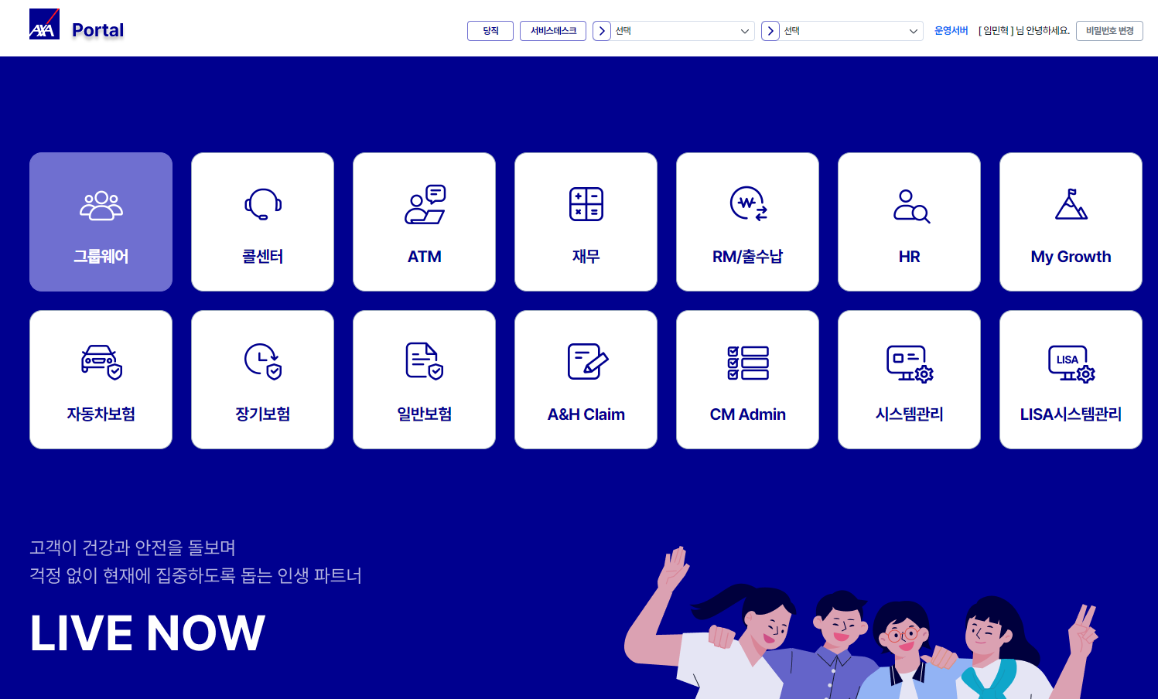
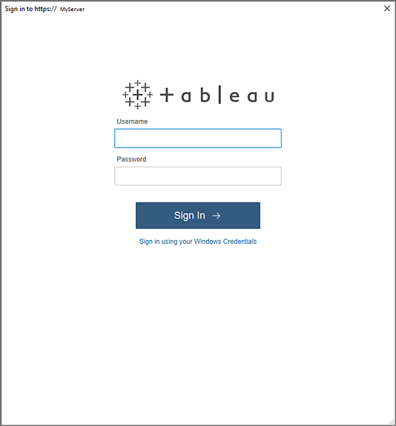

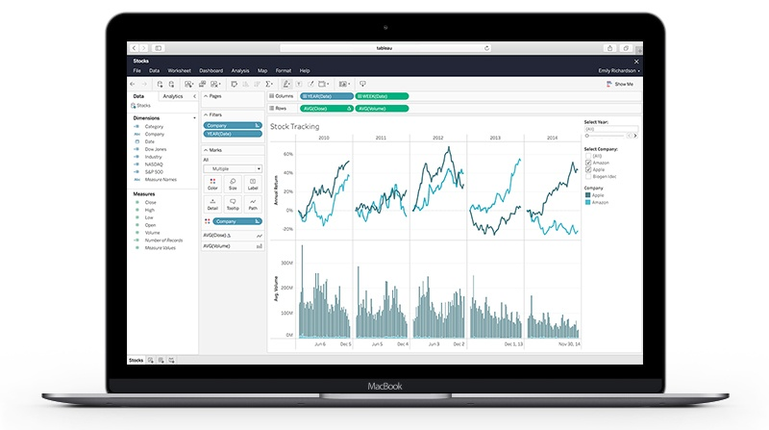










Blueprint of Integration Layout of the Project
The Tableau server is configured only for the operational environment, with the Tableau solution installed that packages Web/WAS, and the database is connected to the existing Realyze DB
Internal USER
WEB
AXA IDC
Tableau Server
Business users
SSL
Tableau Gateway Services
SSO
Data Services
Analytics Services
Content Management Services
Sharing & Collaboration Services
IT STAFF
Backgrounders
Data Sever
Data Engine
VizQL Server
Cache Server
Application Server
Repository & File Store
AXA Cloud
논리적인 Migration 방법
(AP - 김광삼, ProFrame - 노재풍, HR - 노문원) 각각 한장씩
Base Installation(Cluster Controller | Coordination Services)
….
Dedicated Line
Petra
Realyze
10.1.107.100:3299
10.1.107.200:3299
10.1.110.73:33300
RDS
Elasticache
EFS

Slide 17
Key Integration Attention Points (DevOps process)
이승민, 노재풍
특히 ProRule에 대한 Flow가 있어야 함.

Slide 18
System Architecture (AS-IS)
이승민
전체 서버 군 + 서버별 S/W 가 표시되는 그림이 필요함.
WEB, WAS, RD, Nets, Batch Scheduler

Slide 19
System Architecture (TO-BE)
이승민
전체 서버 군 + 서버별 S/W 가 표시되는 그림이 필요함.

Slide 20
김광삼
Service Requirements
What level of service is required for this solution?
Critical Service Requirements | Target Value | How will this be achieved? | What is the business impact of non delivery?
Service Availability (Core application) 자동차 계약, 보상, 일반 계약, TM, 고객, P&R | Standalone service availability > 99% | Standalone process Regular system and data cube backups to ensure quick recovery | Delayed access to dashboards and reports Disruption of management reporting and decision-making processes
Service Availability (Back office application) 재무, HR | Standalone service availability > 95%
SSO Integration | 100% Integration with server | Unified credential and password management Linked portal access and consistent user credential management. | Frequent login failures or confusion for end users Reduced user adoption and satisfaction
DR여부 |  | Frequency and detailed approach will be finalized in consultation with the vendor | Potential data loss or delay in recovery
Note: Please access to the complete SQP list through the following link: Link to latest SQR checklist

Slide 21
Provider / Hosting Architecture
이승민
전체 cloud architecture + legacy : 통신은 Https가 표시 되어야 함.

Slide 22
노재풍
Key Security Requirements and Threats
Measures and services planned and implemented to meet requirement and address threats
Key Security Requirements | (For BP) Implementation Detail
Access Control | Integrate with SSO Define roles for admin, user, and auditor Implement approval-based access request workflows
Data Protection | Use TLS/SSL for data in transit Encrypt databases
Audit Logging & Traceability | Automatically log all access and changes Ensure log integrity Generate audit reports automatically
Threats / Attack Scenarios | (For BP) Implementation Detail
Unauthorized Access to Tableau | Integrate with SSO for centralized identity management Define and enforce role-based permissions
Privilege Escalation by Internal Users | Define strict admin roles Enable audit logging for all admin activities Use approval workflows for privilege changes
Insider Threats (Malicious or Negligent Behavior) | Limit access to only necessary systems Review access logs regularly

Slide 23





노재풍
Detailed Security Architecture
Tableau Server is securely accessed via SSO within an on-premise environment, with controlled integration to external systems for compliance and security.
Category | Compliance Approach
Network Security Architecture | Ensure secure data transmission using SSL Implement firewalls and access control policies
Authentication & Authorization | Apply SSO for all users and systems Use RBAC (Role-Based Access Control) to restrict access based on user roles
Data Protection | Encrypt data in transit (TLS/SSL) Apply data masking and anonymization for sensitive information Monitor data access and integrate with anomaly detection systems
Server Protection | Deploy EDR (Endpoint Detection and Response) Ensure regular patching and vulnerability scanning
AXA IDC
Tableau Server
SSL
EDR
SSO
User
SEP
Qulays
Petra
Encryption
Administrator
Servers

Slide 24
노재풍
Security Application Checklist
■ 프로젝트 수행 범위
No. | 구분 |  |  |  |  |  | (O,X체크해주세요) | Comment
1 | 프로젝트 범위에 클라우드 이용이 포함된다 (AWS, GCP, SaaS 등). |  |  |  |  |  | X | ex. AWS 시용
2 | 프로젝트 범위에 개인정보/신용정보/민감정보/연계정보의 처리가 포함된다. |  |  |  |  |  | X
3 | 프로젝트 범위에 Web/App 서비스가 포함된다. |  |  |  |  |  | O
4 | 프로젝트 범위에 외부 시스템과의 연계/연동이 포함된다 |  |  |  |  |  | X | Tableau 서버 웹페이지 제공
5 | 프로젝트 범위에 외주 개발자의 투입이 포함된다 |  |  |  |  |  | X
6 | 프로젝트 범위가 전자금융업무에 해당된다 |  |  |  |  |  | X
7 | 프로젝트 범위에 생성형 AI가 사용된다 (ChatGPT 등) |  |  |  |  |  | X
8 | 프로젝트 범위에 H/W와 S/W의 도입이 포함된다 |  |  |  |  |  | O | ex. Server, DB, Apache 등
■ 보안 점검 계획
No. | 구분 |  |  |  | 해당 수행 범위 | 담당자 | 수행 계획 | 비고
1 | 보안성 심의 |  |  |  | 4, 6 | N/A
2 | 보안요건 정의서 |  |  |  | All | 이광운, 이서현 | ~2025.11.20 | 계약 체결 단계
3 | Pentest Test |  |  |  | 3 | 이서현 | 2026.04.01~04.24 | 테스트 단계
4 | 인프라 하드닝(CIS Benchmark) |  |  |  | 1, 8 | 이서현, 임민혁 | ~2025.12.19 | 도입, 설치 단계
5 | 소스코드 점검 |  |  |  | 3 | 이서현 | 2026.02.02~04.24 | 개발 단계
6 | 시큐어 코딩 교육 / 보안 교육 계획 및 실적 |  |  |  | 5 | N/A
7 | Digital Permit |  |  |  | 3 | N/A
8 | Vendor Security Due Diligence Tooling |  |  |  | All | 이광운, 조성민 | ~2025.11.20 | 계약 체결 단계
9 | 인프라 취약점 점검 |  |  |  | 1, 8 | 이서현, 임민혁 | ~2025.12.19 | 도입, 설치 단계
10 | AI Risk Assessment |  |  |  | 7 | N/A

Slide 25
4. Approach Focus

Slide 26
백성규
Project Schedule
Tasks |  | Apr |  | May |  |  |  | Jun |  |  |  | Jul. |  |  |  | Aug. |  |  |  | Sep. |  |  |  | Oct. |  |  |  | Nov. |  |  |  | Dec. |  |  |  | Jan. |  |  |  | Feb. |  |  |  | Mar. |  |  |  | Apr. |  |  |  | May.
 |  | W1 | W2 | W3 | W4 | W5 | W6 | W7 | W8 | W9 | W10 | W11 | W12 | W13 | W14 | W15 | W16 | W17 | W18 | W19 | W20 | W21 | W22 | W23 | W24 | W25 | W26 | W27 | W28 | W29 | W30 | W31 | W32 | W33 | W34 | W35 | W36 | W37 | W38 | W39 | W40 | W41 | W42 | W43 | W44 | W45 | W46 | W47 | W48 | W49 | W50 | W51 | W52
Project Management | Project Management
Requirements Analysis and Design | Project Analysis
 | Define Project Scope and Requirement
 | Tool Selection and Alignment
Data Mart | Define Topline Data and Layout
 | Data Migration
 | Build Data Mart Query
 | Query & Data Verification
Internal Preparation | POC Period
 | RFP & Vendor Contract
 | Tableau Server & SSO
 | Security Check
Vendor | Dashboard Creation
 | UAT
 | End user Training
Gate 1
(9/10)
Gate 2 BAU
(11/17)
Kick-off
(04/17)
LARB
(11/12)
Open & Completion
(05/06, Gate 3 TBU)
√
√
√
√
1. Security Requirements Definition Documents
2. Vendor Security Due Diligence Tooling
Source Code Review
Pentest Test
1. Infrastructure Vulnerability Assessment
2. CIS Benchmark

Slide 27
백성규
Project Cost Details
(Unit: mKRW)
Type | Category | Cost Details | Unit Cost | Unit | 2025 | 2026 | 2027 | 2028 | 2029 | Total | Remarks
Cockpit Project | CAPEX | Tableau Infrstructure | 21.7 | 1 | 23.9 | - | - | - | - | 23.9 | Server
 |  | SSO | 7.8 | 1 |  | 8.6 | - | - | - | 8.6
 |  | Tableau Consultant (Senior) | 14.0 | 3 |  | 46.2 | - | - | - | 46.2
 |  | Tableau Consultant (Junior) | 9.5 | 3 |  | 31.4 | - | - | - | 31.4
 |  | Tableau Consultant (Junior) | 9.5 | 3 |  | 31.4 | - | - | - | 31.4
 |  | Technical support (Senior) | 14.0 | 0.5 |  | 7.7 | - | - | - | 7.7
 |  | Discount |  |  |  | - 14.3 | - | - | - | - 14.3
 | CAPEX Subtotal |  |  |  | 23.9 | 111 | - | - | - | 134.8
 | OPEX | Tableau License (Creator) | 1.0 | 10 |  | 11.0 | 11.0 | 11.0 | 11.0 | 44.0
 |  | Tableau License (Viewer) | 0.2 | 40 |  | 8.8 | 8.8 | 8.8 | 8.8 | 35.2
 |  | Wiring & Other expenses | 1.0 | 1 |  | 1.1 | - | - | - | 1.1
 |  | Maintenance Cost |  |  |  |  | 4.9 | 4.9 | 4.9 | 14.6 | 15% of Server & SSO
 | OPEX Subtotal |  |  |  | - | 20.9 | 24.7 | 24.7 | 24.7 | 94.9
 | Total |  |  |  | 23.9 | 131.8 | 24.7 | 24.7 | 24.7 | 229.7

